Slide 1
CAPSTONE PROJECT Automation of OpenMRS Hospital Management System
Amogh M
Java selenium batch – 4
Superset id: 5573126

Slide 2
CONTENTS
Tools & Technologies Used
Project Explorer
Test Runner
Feature Files
Step Definitions
Page Objects
Screenshots
Extent Report
Console Output
GitHub Repository

Slide 3
TOOLS & TECHNOLOGIES USED
Java – Programming language for writing test scripts.
Selenium WebDriver – For browser automation and interaction.
Maven – Build automation and dependency management tool.
TestNG – Testing framework for organizing and executing test cases.
Cucumber BDD – Behavior Driven Development tool for writing tests in Gherkin syntax.

Slide 4
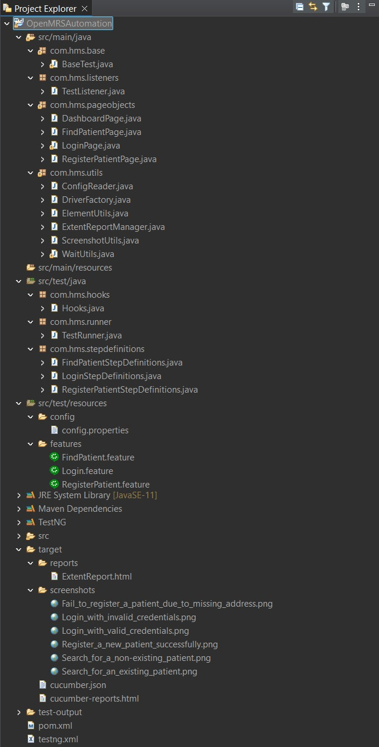
PROJECT EXPLORER

Slide 5
TestRunner.java
Runs all Cucumber scenarios (Login, Register Patient, Find Patient).
Connects .feature files with corresponding Java step definitions.
Generates reports (HTML, JSON, Extent Reports) for analysis.
Enables selective execution of tests using tags like @Positive and @Negative.
Provides integration between TestNG and Cucumber to execute tests.
Central place to configure glue paths (step definitions, hooks, utilities).
Helps maintain modular and scalable test execution as the project grows.

Slide 6
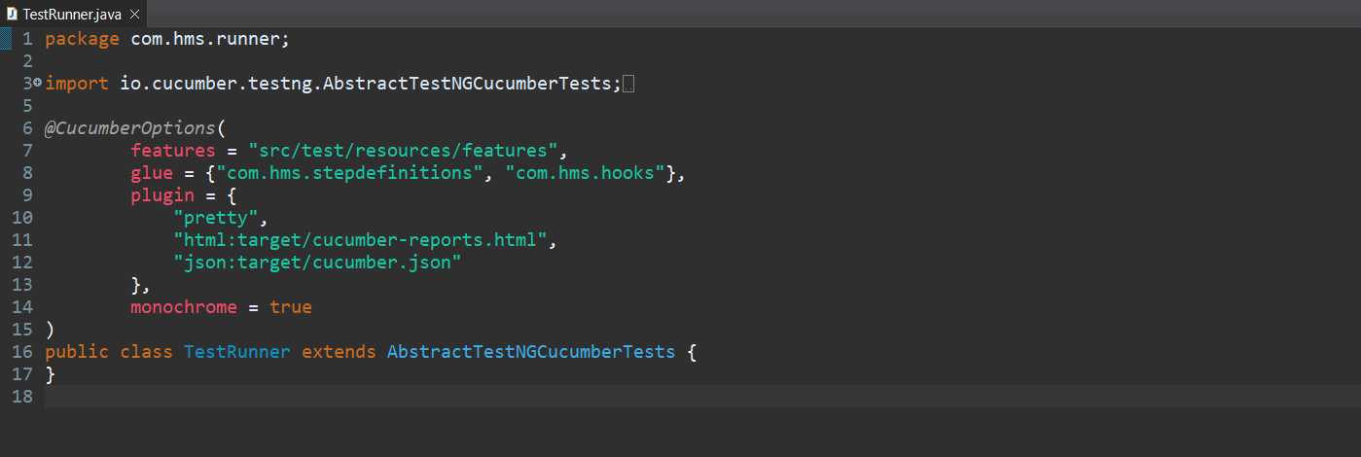
TestRunner.java

Slide 7
Feature Files
Feature files are written in Gherkin syntax and describe application behavior in a human-readable format.
They contain Scenarios and Steps that define test cases in the form of Given-When-Then.
In your project, feature files include:
Login.feature → verifies positive and negative login flows.
RegisterPatient.feature → tests adding a new patient with both valid and invalid data.
FindPatient.feature → checks searching for existing and non-existing patient records.
They act as a bridge between business requirements and test automation.
Enable collaboration between testers, developers, and non-technical stakeholders.
Provide clear documentation of test scenarios, which can double as requirements.

Slide 8
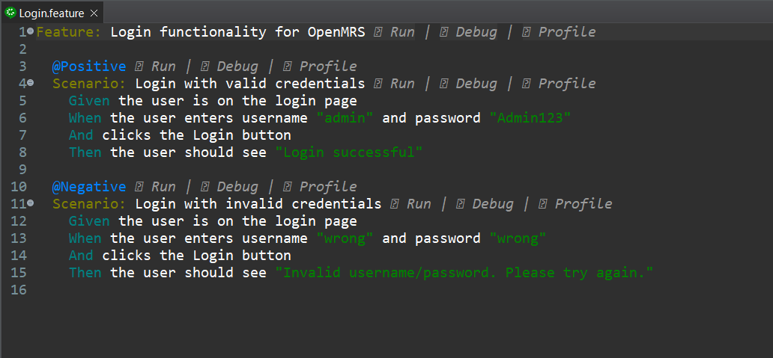
Login.feature

Slide 9
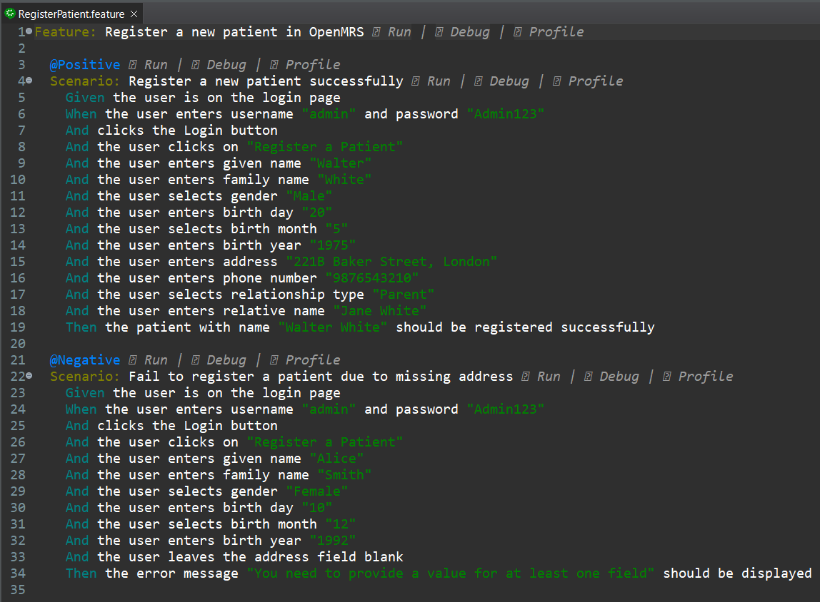
RegisterPatient.feature

Slide 10
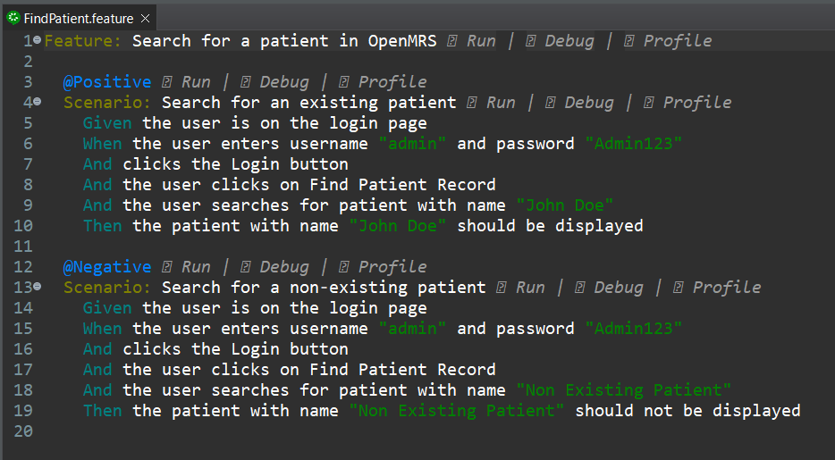
FindPatient.feature

Slide 11
Step Definitions
Step Definitions contain the Java code that executes each step from the feature file.
They act as a glue between Gherkin steps (Given-When-Then) and actual Selenium/TestNG automation code.
LoginStepDefinitions.java → Implements login scenarios with valid and invalid credentials.
RegisterPatientStepDefinitions.java → Automates patient registration workflows (positive and negative).
FindPatientStepDefinitions.java → Implements search functionality for patients.
They use Page Object methods for clean, reusable automation.
Provide traceability by directly linking requirements (feature files) to automation logic.
Make test scripts readable, maintainable, and modular.

Slide 12
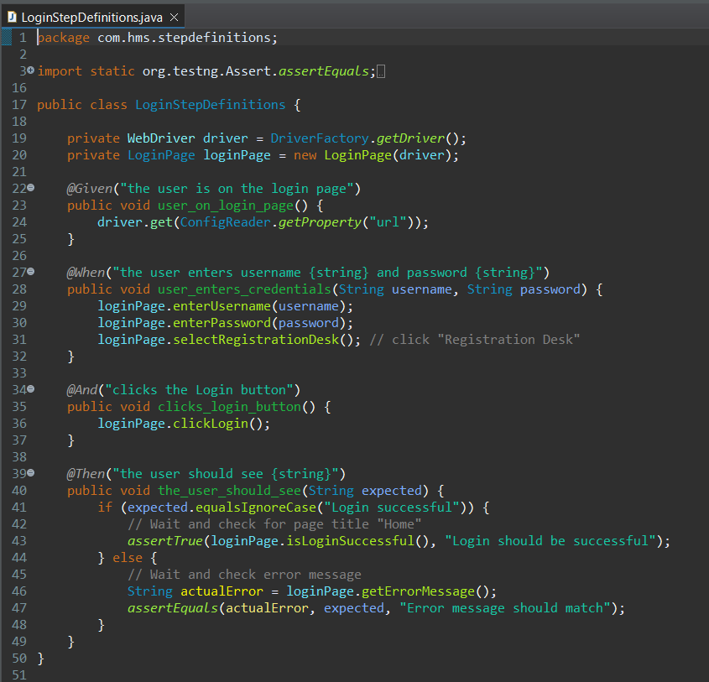
LoginStepDefinitions.java

Slide 13
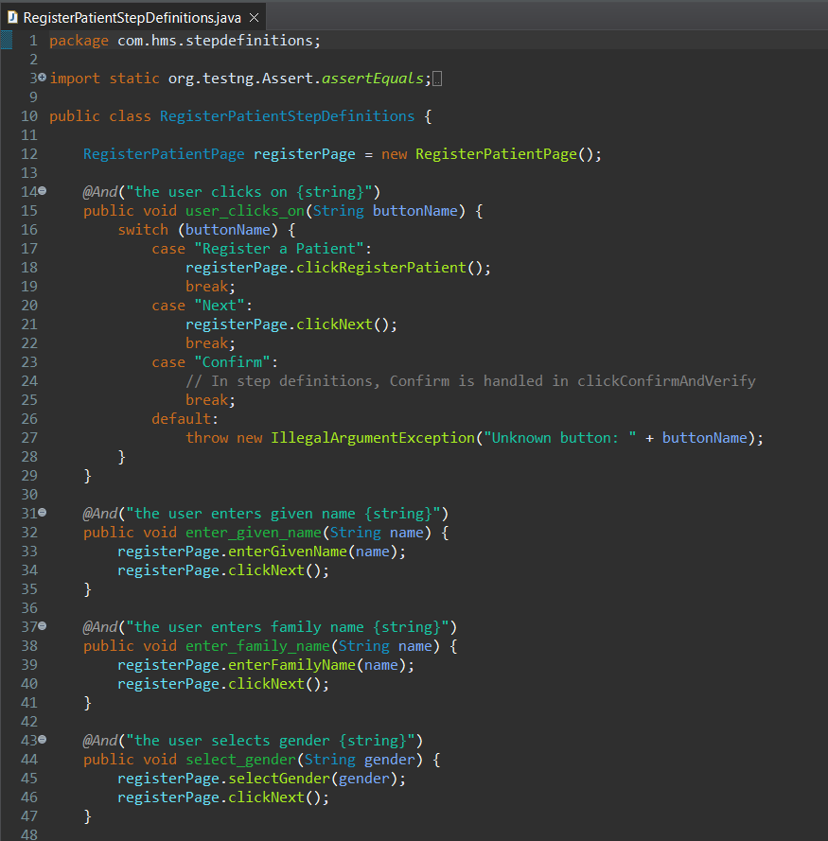
RegisterPatientStepDefinitions.java

Slide 14
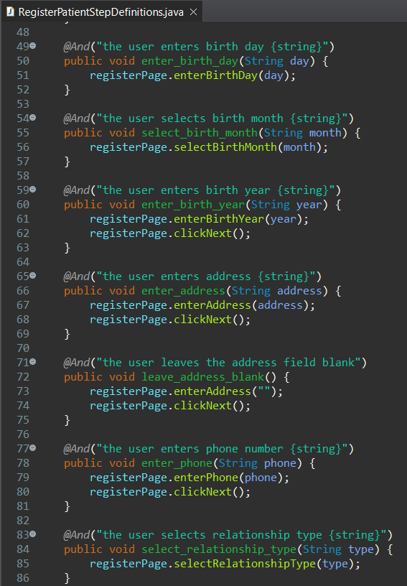
RegisterPatientStepDefinitions.java

Slide 15
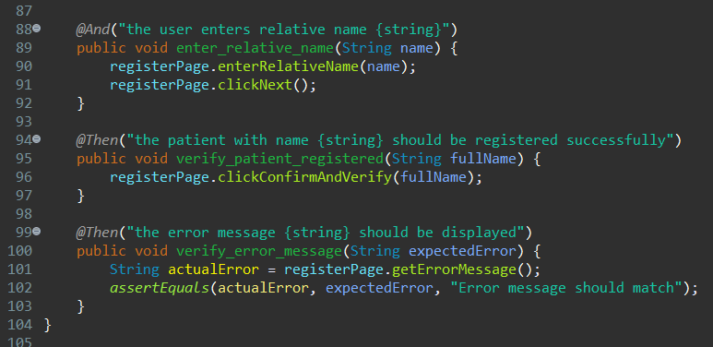
RegisterPatientStepDefinitions.java

Slide 16
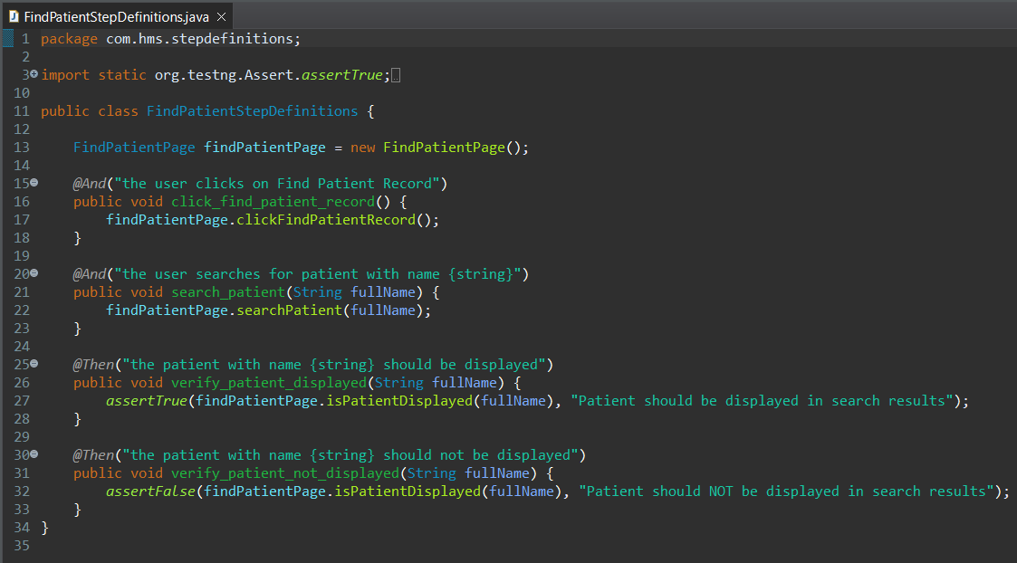
FindPatientStepDefinitions.java

Slide 17
Page Objects
Each web page is represented by a dedicated Java class (e.g., DashboardPage.java, LoginPage.java, RegisterPatientPage.java, FindPatientPage.java).
They follow the Page Object Model (POM) design pattern in Selenium.
Locators for web elements are stored inside these classes, ensuring no duplication.
Reusable methods (e.g., enterUsername(), clickLogin()) define the actions a user can perform on that page.
Step Definitions reuse these methods, keeping test logic separate from UI details.
This structure makes the automation framework clean, modular, and easy to maintain.
Helps in scalability: when UI changes, only Page Object files need updates, not all step definitions.

Slide 18
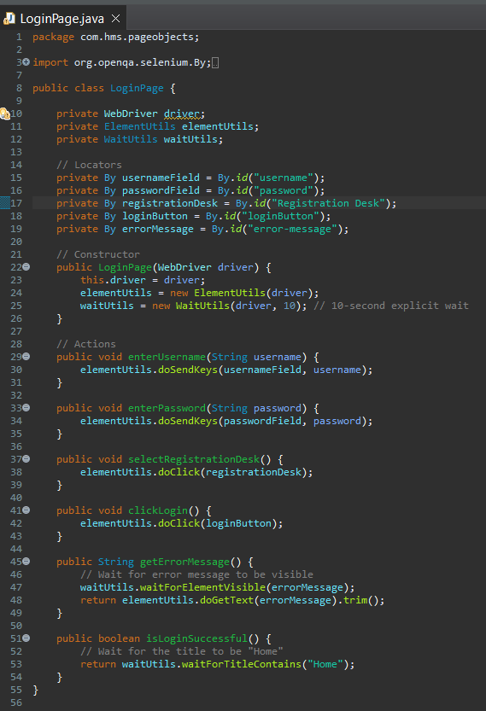
LoginPage.java

Slide 19
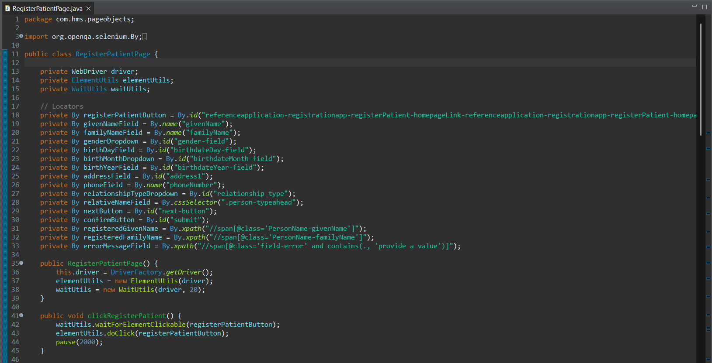
RegisterPatientPage.java

Slide 20
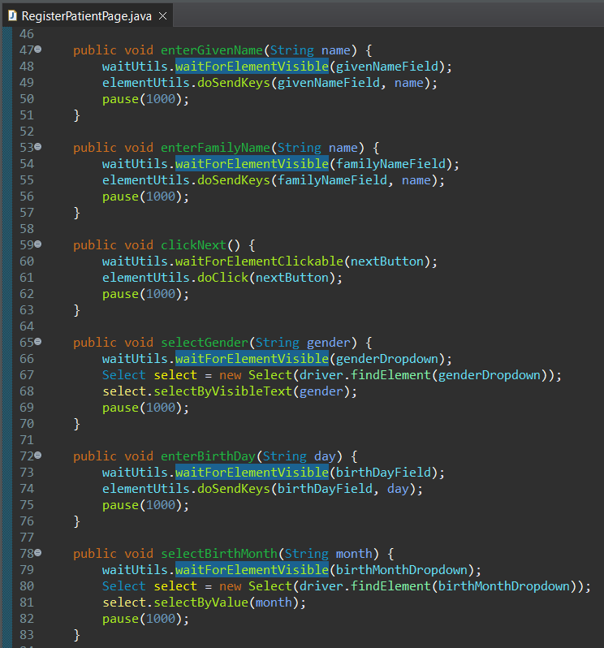
RegisterPatientPage.java

Slide 21
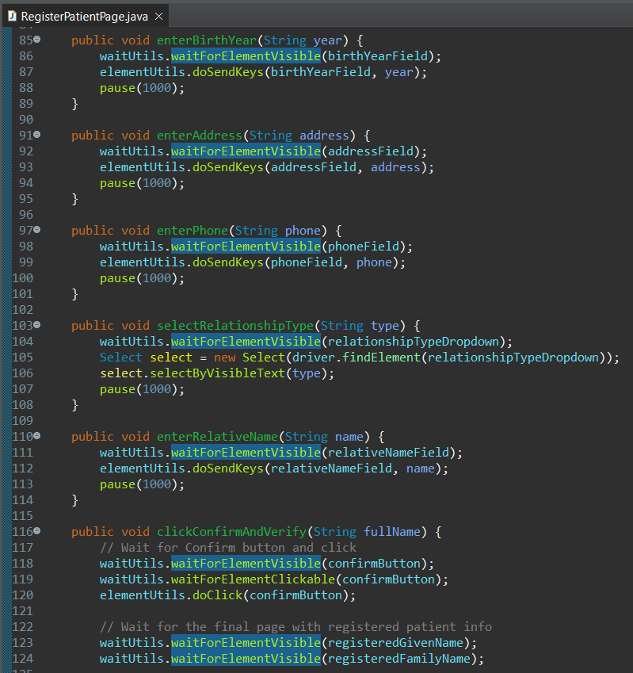
RegisterPatientPage.java

Slide 22
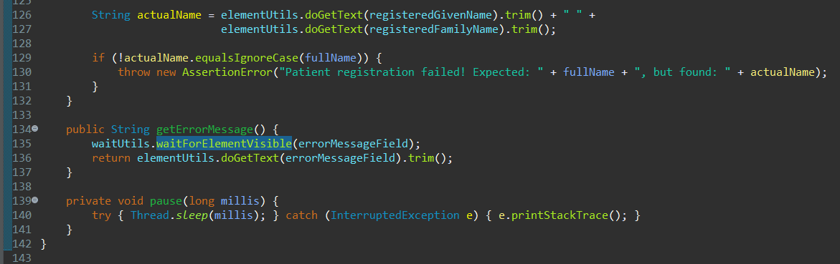
RegisterPatientPage.java

Slide 23
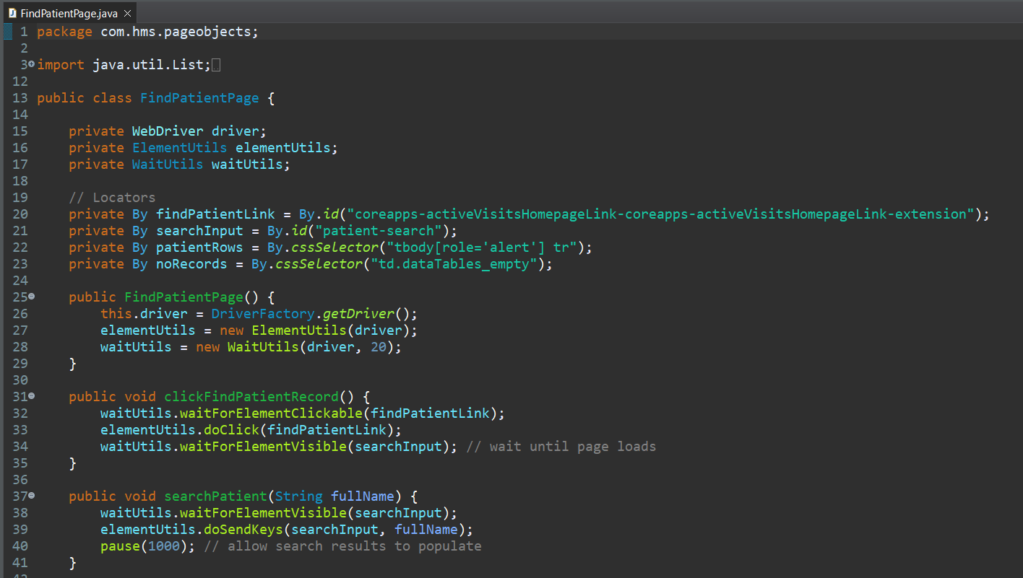
FindPatientPage.java

Slide 24
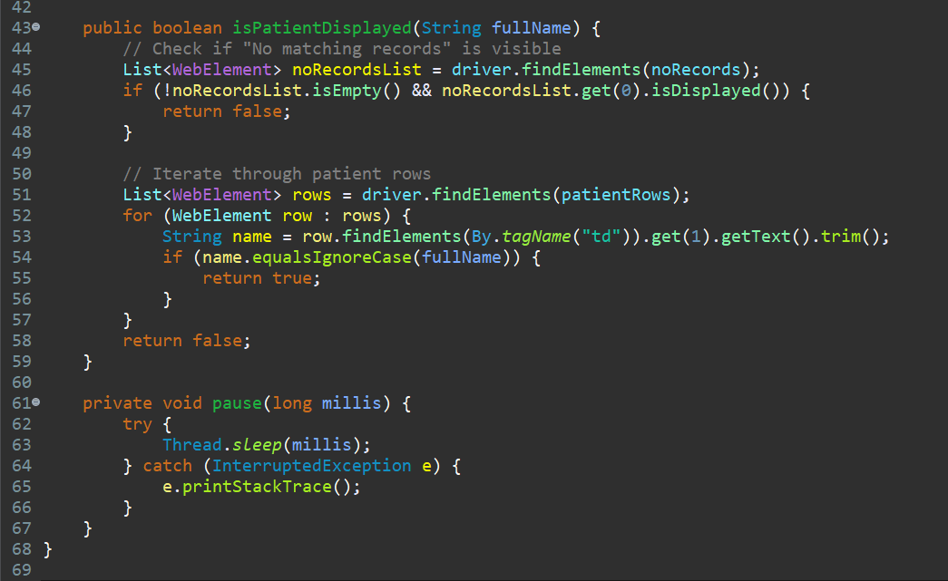
FindPatientPage.java

Slide 25
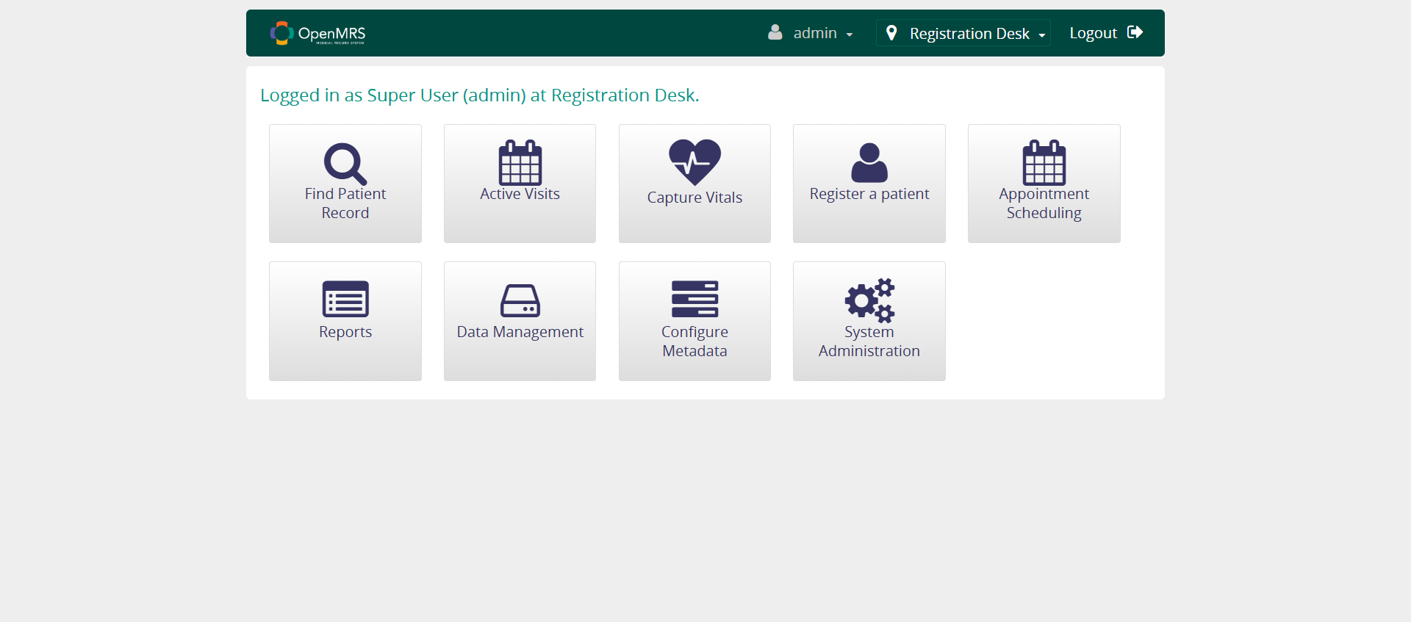
Screenshots
Testcase 1: Login with valid credentials.

Slide 26
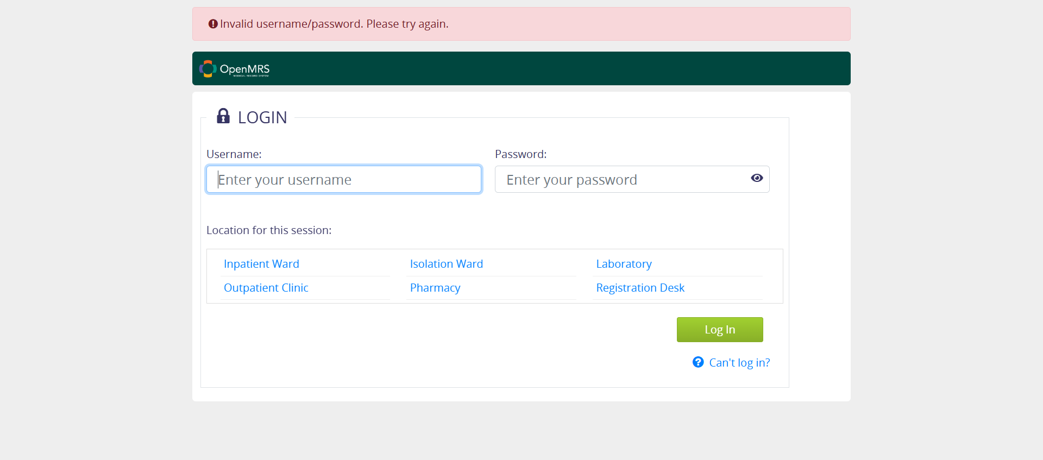
Screenshots
Testcase 2: Login with invalid credentials.

Slide 27
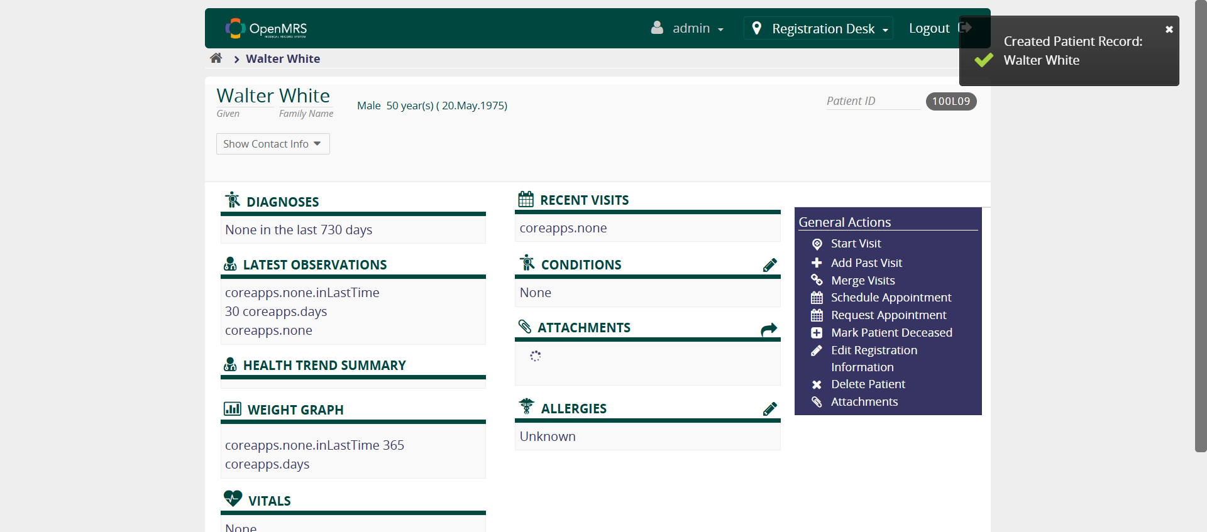
Screenshots
Testcase 3: Register a new patient successfully.

Slide 28
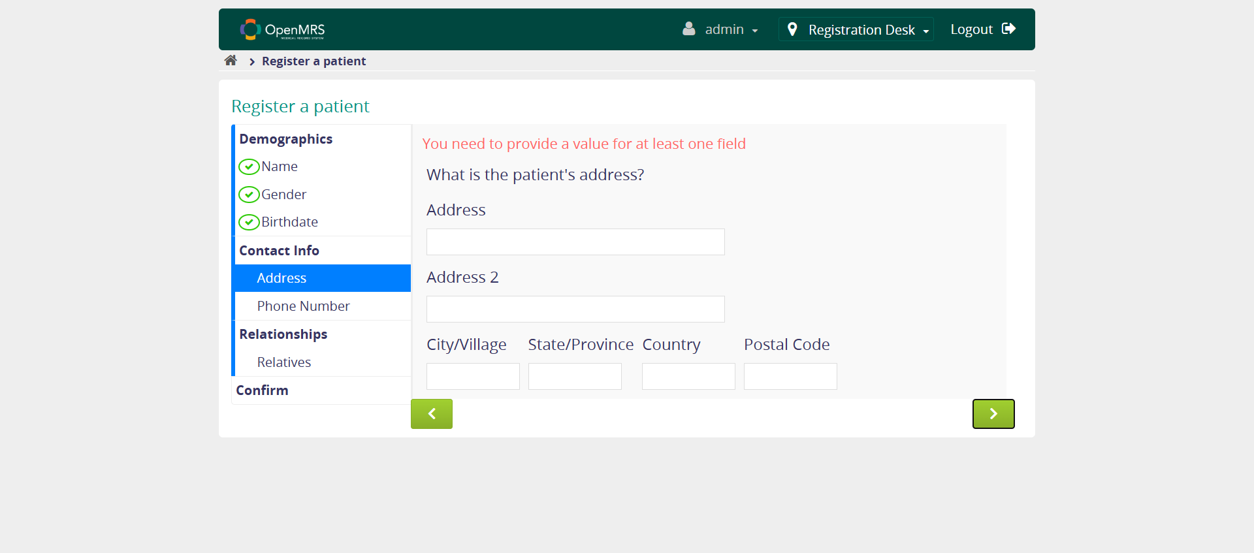
Screenshots
Testcase 4: Fail to register a new patient due to insufficient details.

Slide 29
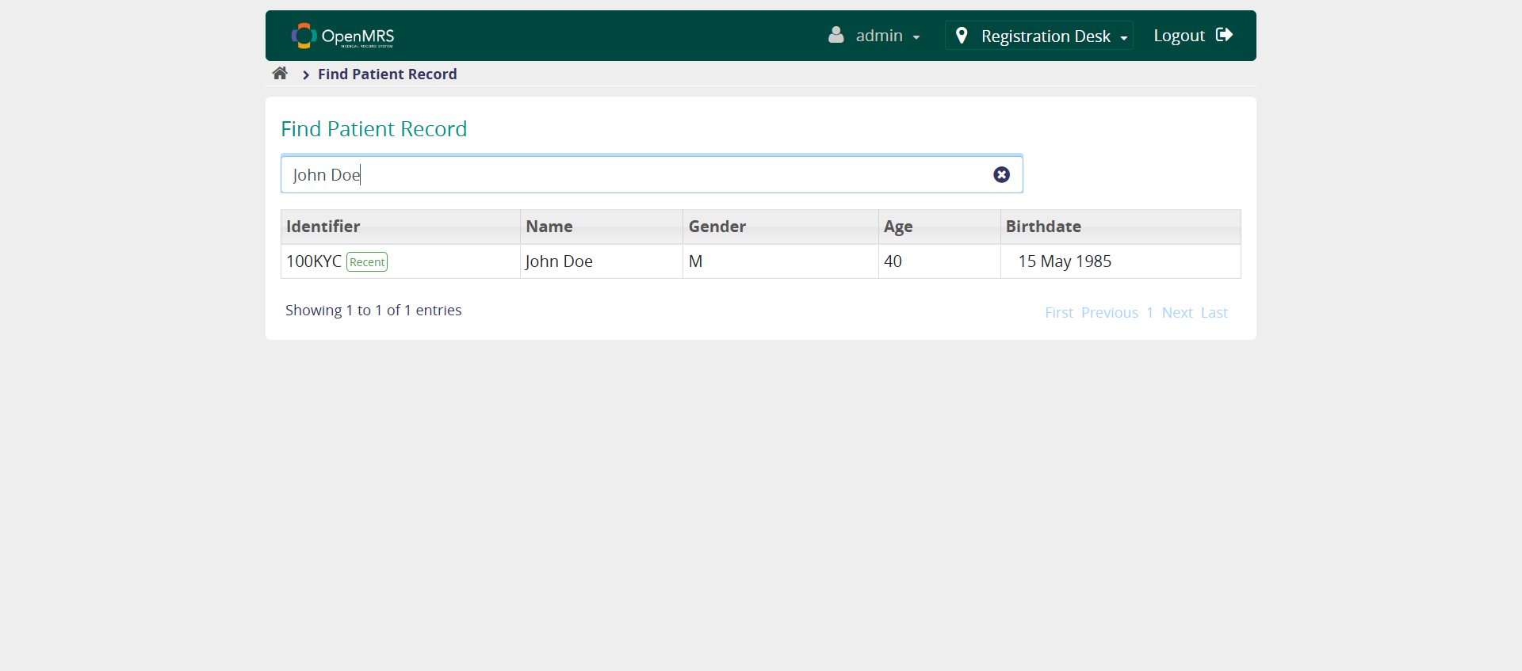
Screenshots
Testcase 5: Search for an existing patient.

Slide 30
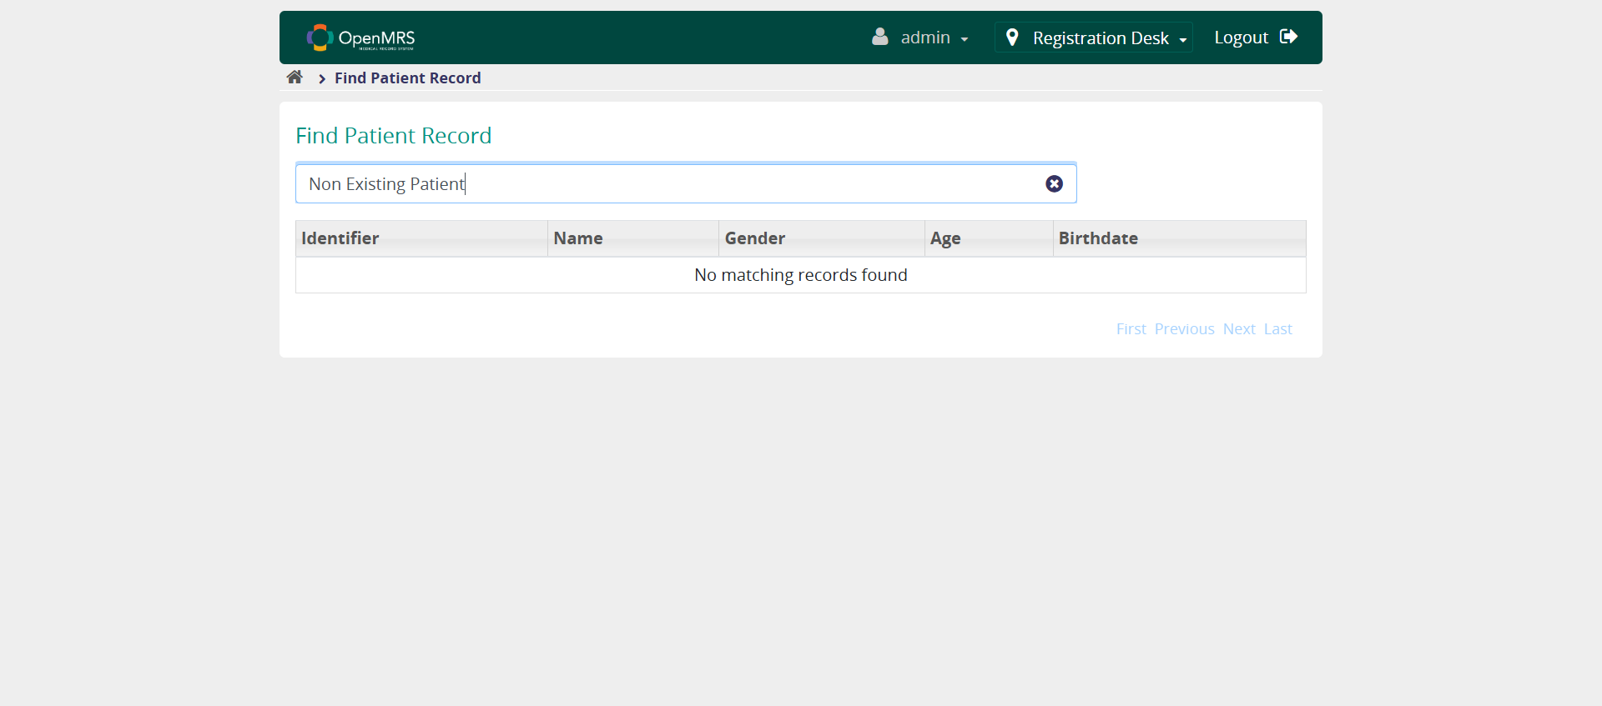
Screenshots
Testcase 6: Search for a non existing patient.

Slide 31
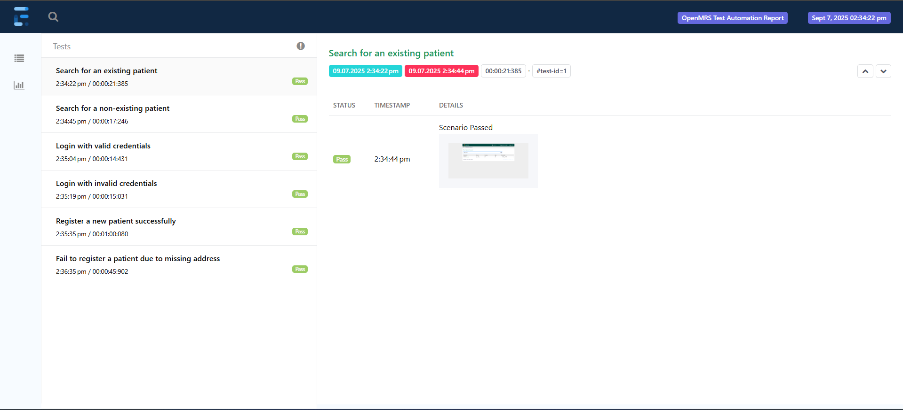
Extent Report

Slide 32
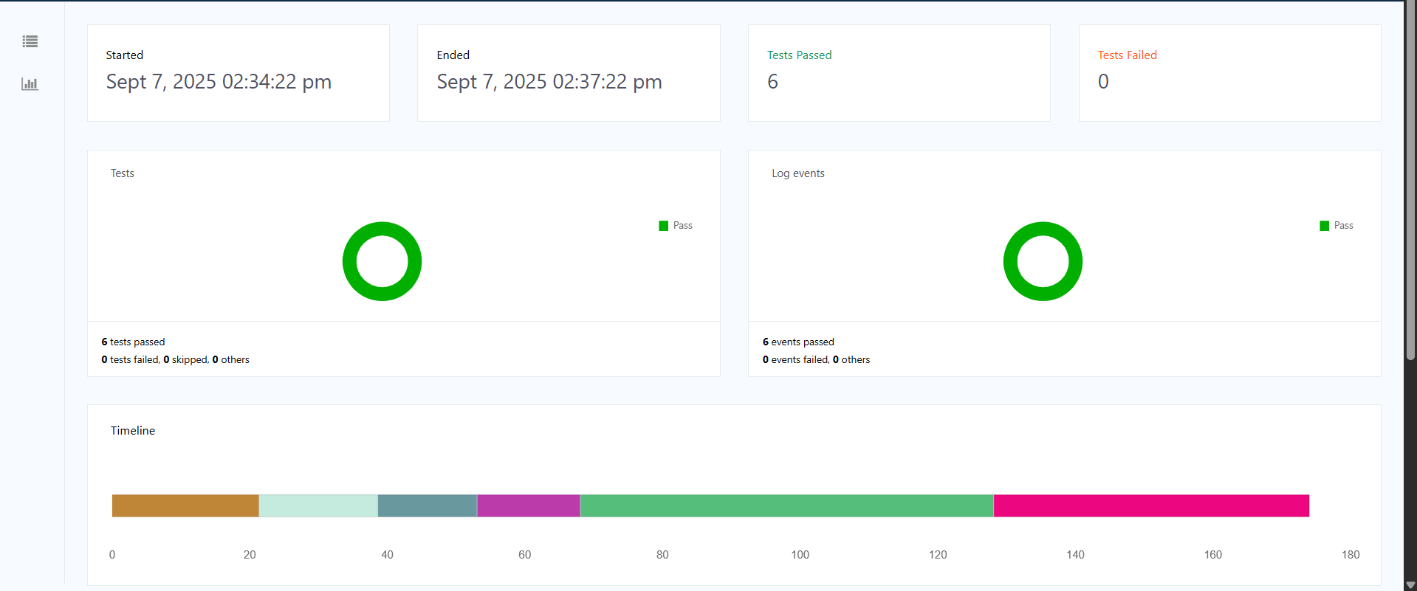
Extent Report

Slide 33
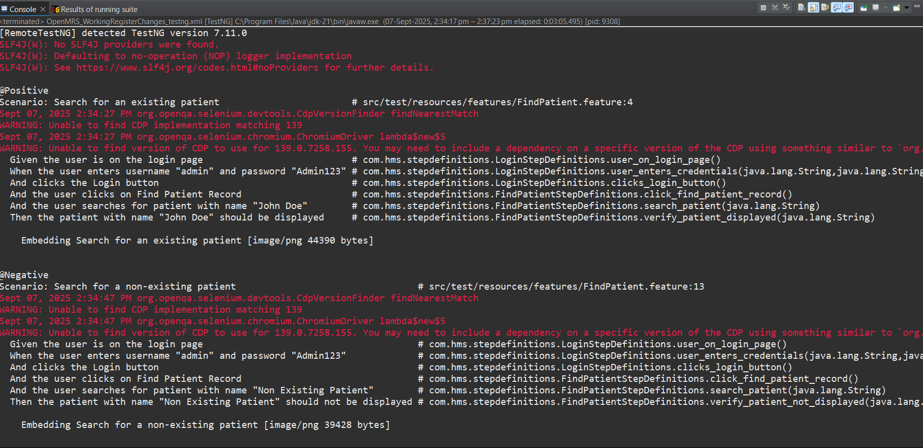
Console Output

Slide 34
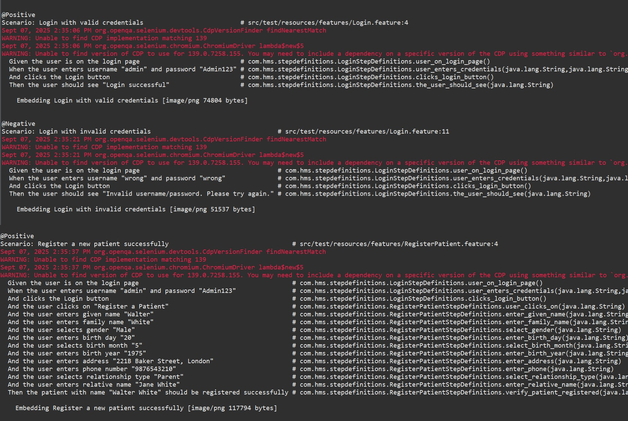
Console Output

Slide 35
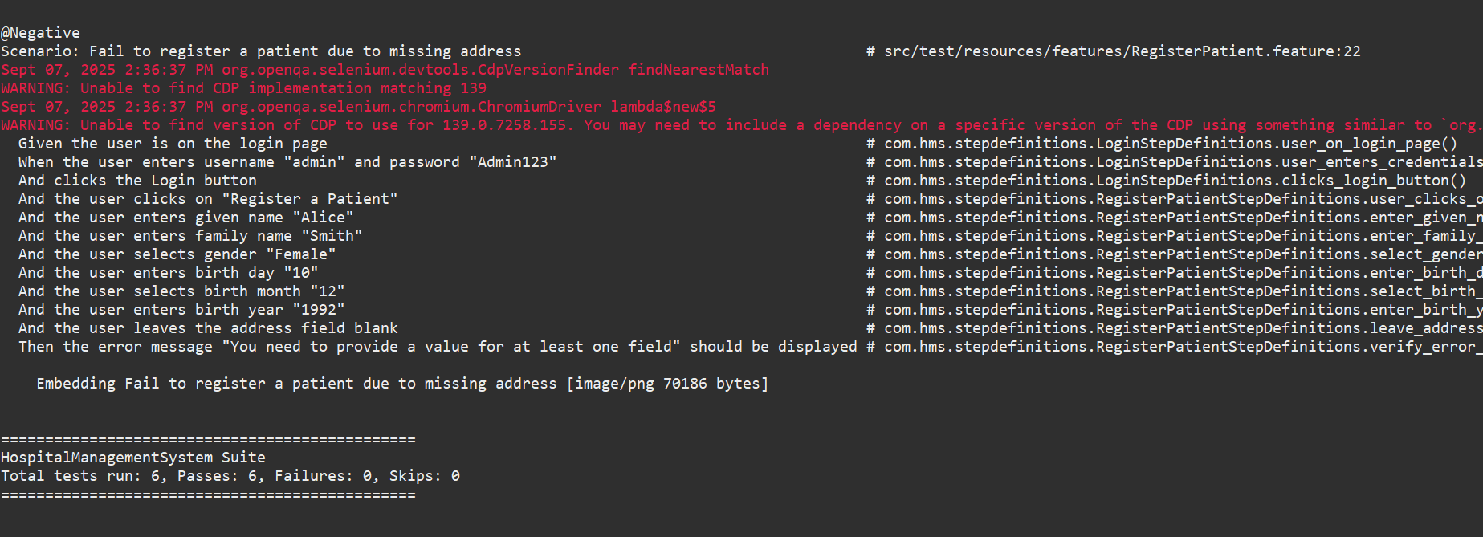
Console Output

Slide 36
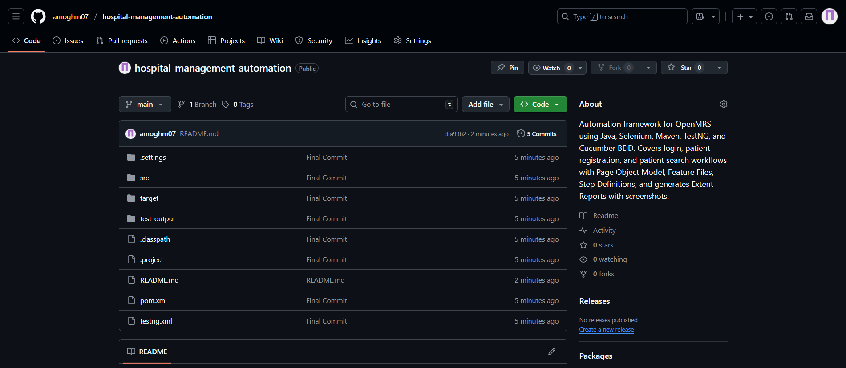
GitHub Repository GitHub Repository Link

Slide 37
THANK YOU

